Slide 1

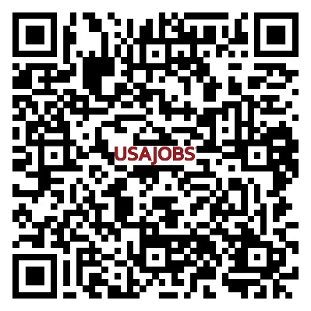
NSA Naples School Liaison
Ms. Sarah Dastrup | School Liaison
Want to work?
Hiring Fairs
August 29 at Capo CDC at 9 a.m.-12 p.m.
September 24 at Support Site CDC at 9 a.m.-12 p.m.
Full-time, part-time and flex positions
Benefits
$500 sign on bonus
Up to $1750 retention bonuses
100% child care discount (NEW! Begins Sept. 1.)
Tuition assistance…and more!
Scan here for vacancies:
www.usajobs.gov
Search “CYP” and “Naples, Italy”

Slide 2
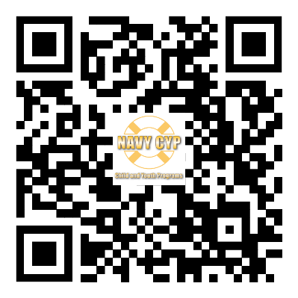
NSA Naples School Liaison
Ms. Sarah Dastrup | School Liaison
Want to be a Youth Sports volunteer coach?
Do you want to make a difference in the life of a child?
Must be 18 or older.
Large variety of sports available.
Learn what is needed:

Slide 3
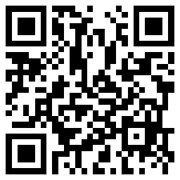
NSA Naples School Liaison
Ms. Sarah Dastrup | School Liaison
How can the School Liaison help you?
School registration navigation
Individual Education Plan (IEP) assessments and transfers
Graduation requirement issues
International school options for all ages
Homeschool requirements
Reach out and connect across platforms:

Slide 4
NSA Naples School Liaison
Ms. Sarah Dastrup | School Liaison
School Advisory Committee (SAC)
School policies toward students and parents, student activities, and administrative procedures affecting students.
Instructional programs and educational resources.
Allocation of resources to achieve educational goals.
Pupil services (health, special education, testing, evaluation, counseling, and extracurricular activities).
Student standards of conduct and discipline.
Installation Advisory Committee (IAC)
Quality, availability, maintenance, safety, security, and comfort of the physical school environment.
Transportation of students.
School meal programs.
Medical services.
Administrative and logistical support services provided to the school.
Elementary SAC, Middle High SAC and IAC
each meet four times per school year
Make recommendations and advise the principal.
Make recommendations and advise the installation commander.

Slide 5
NSA Naples School Liaison
August
Ms. Sarah Dastrup | School Liaison
Events
Aug. 14 Hawaiian Luau at 5-6:30 p.m. at Teen Center for 7-12 graders and parents
Aug. 15 Homeschool Happening “Madagascar 3: Europe's Most Wanted” at 12-2 p.m. at Reel Times 2 Cinema for parents and students of all ages
Aug. 16 Back to School Bash at 3-6 p.m. at Central Park
Aug. 16 Parent Education Topic: Communication Skills at 4:30-5:00 p.m. at School Age Care (SAC) for parents of all age youth
Aug. 19 Back to the Future at 2:30-4:30 p.m. at Teen Center for 7-12 graders
Aug. 23 Sips with CYP and SL at 7:45-8:45 a.m. at NES/NMHS Front Sidewalk for parents
Aug. 23 Meet the MFLCs at 7:45-8:45 a.m. at NES/NMHS Sidewalk

Slide 6
NSA Naples School Liaison
September
Ms. Sarah Dastrup | School Liaison
Events
Sep. 13 Retro Revival at 7-9 p.m. at Teen Center for 7- 8 graders
Sep. 14 Positano and Beach Trip at 9 a.m.-7 p.m. for 9-12 graders
Sep. 19 Parent Education Topic: Keep Talking Dinner Conversation
at 4:30-5:00 p.m. at School Age Care (SAC) for parents of
all age youth
Sep. 23-27 Tutor.com/military presentations and workshops

Slide 7
NSA Naples School Liaison
October
Ms. Sarah Dastrup | School Liaison
Events
Oct. 2 Bike, Walk and Roll Day
Oct. 11 CYP facilities CLOSED for In-Service Training
Oct. 17 Parent Education Topic: 7 Strategies to Master Emotions
at 4:30-5:00 p.m. at School Age Care (SAC) for parents of
all age youth
Oct. 17 Bullying, Cyberbullying and Social Media 101 at 5:00-6:30 p.m. at NES for all students and parents
Oct. 19 Sensory Friendly Movie Event at 12-2 p.m. at Reel Times 2 Cinema for all families
Oct. 25 Rome Colleges Trip at 8 a.m. to 8 p.m. (approximate) for 9- 12 graders
Oct. 30 Sensory Friendly Halloween Party at 1-3 p.m. at Youth Programs Gym for sensory friendly needed families

Slide 8
NSA Naples School Liaison
November
Ms. Sarah Dastrup | School Liaison
Events
Nov. 5 Paying for Higher Education at 5-6:30 p.m. at NMHS
Nov. 15 Homeschool Happening at 2:30-4:30 p.m. at Strikers Bowling Center and Spinz for parents and students of all ages
Nov. 15 Meet the SL at 6-8 p.m. at O’Rhys Irish Pub for parents
Nov. 19 College and Career Fair at 1-4 p.m. at NMHS for students and parents
Nov. 21 Parent Education Topic: Emotional Intelligence at 4:30- 5:00 p.m. at School Age Care (SAC) for parents of all age youth

Slide 9
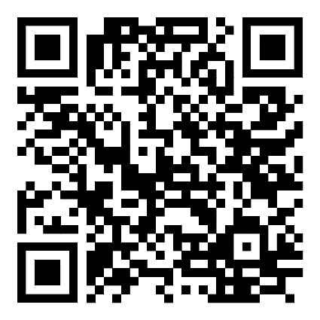
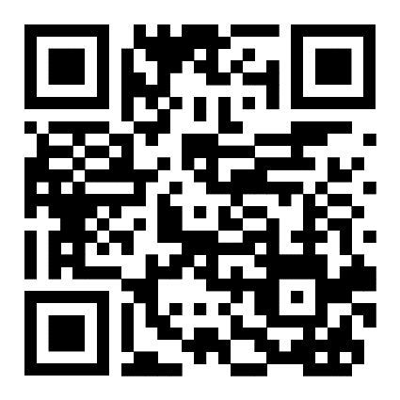
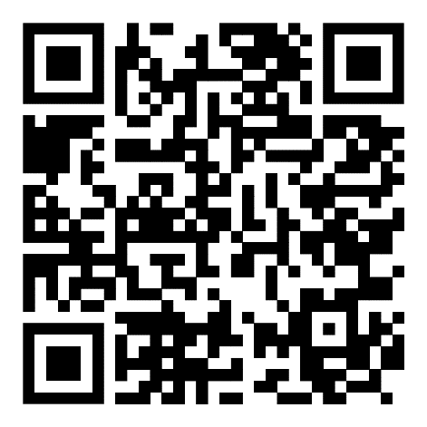
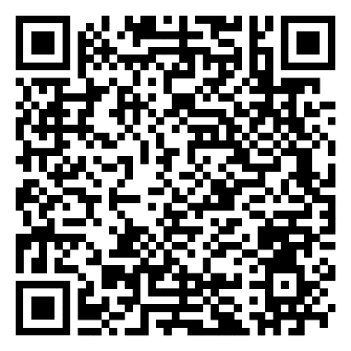
NSA Naples School Liaison
Ms. Sarah Dastrup | School Liaison
Want more information???
Naples Child and Youth Programs Facebook page
Navy MWR Naples Webpage
Navy Life Naples (App Store)
Navy Life Naples (Google Play)

